Slide 1

Mutagenicity QSPR Model
Aditi Vishwas Kamble
IIT (BHU) Varanasi

Slide 2

Plan Of Action
1
EDA of the test data
2
Feature selection
3
Training and testing the KNN
4
Hyper Parameter Tuning

Slide 3

Feature Selection
The Dataset contains 15 features which is huge.
Thus there was a need for feature selection

Slide 4


Unamed:0 and Id: Serve only the pupose of indexing
‘Status’ is same for all the rows
Ruled out features
CAS and SMILES just a way to present the structure
Due to high correlation NoValence and MolMR are removed

Slide 5


All About Model
KNN Model is used
Target Variable is Predicted Value
Hyperparameter tuning is done for better f1 score

Slide 6

Approach
Initally we trained model on 80% data
Real results although need comparison with Experimental value
Thereby we then used complete dataset after removing Experimental value for training

Slide 7
And then the data was tested with real Experimental values
Although the scores we got were bit less than the one which we got by splitting data.
Hyperparameter tuning was done then.

Slide 8


scores with Experimental Value
scores of test, train split
F1 score=0.85
F1 score=0.825
Precision =0.837
Precision =0.818
Recall =0.869
Recall =0.832

Slide 9
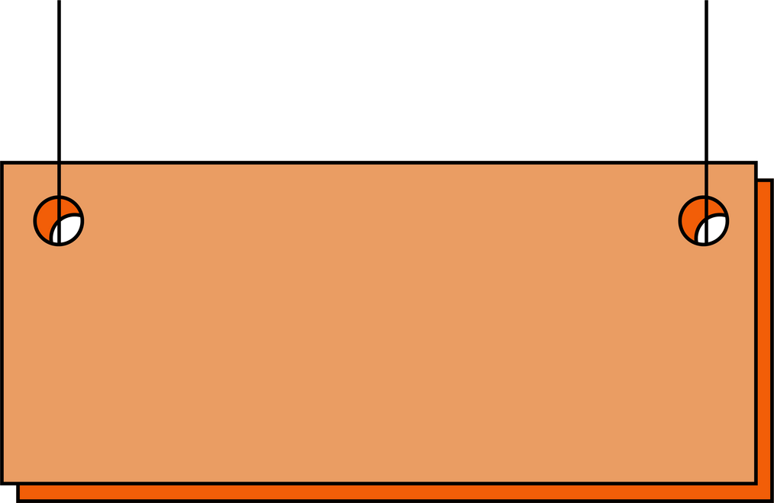
Hyperparameter Tuning
Grid Search CV
Random Search CV

Slide 10
Grid search cv
Random search cv
F1 score=0.724
F1 score=0.825
Precision =0.69
Precision =0.818
Recall =0.76
Recall =0.832

Slide 11

Verdict on basis of scores
Random Search CV
Grid Search CV

Slide 12


Results
F1 score of 0.825.
Precision score of 0.818.
Recall score of 0.832.

Slide 13
Thank You

